Slide 1

ES117: World of Engineering
Open Project : Stroke Rehabilitation Glove
Goraksh Bendale
Manas Gharpure
Siddhesh Umarjee
Arnav Gogate
Apoorv Rane
Dhruv Jalan
Amended with further development made during Semester II 23-24: ES115 Design Innovation and Prototyping

Slide 2
Introduction
This project presents an innovative approach to stroke rehabilitation through a sensor-equipped glove designed to track hand movements and orientation while providing engaging rehabilitation exercises. The system combines flex sensors and IMU sensors to create a gamified rehabilitation experience that increases patient engagement and adherence to therapy regimens. Our preliminary findings suggest that this approach could significantly improve the rehabilitation experience and potentially lead to better outcomes for stroke survivors compared to traditional methods.

Slide 3
Problem Statement
Stroke remains a leading cause of long-term disability worldwide, especially hand impairment, causing patients to lose fine-motor control. Traditional hand rehab methods exhibit the following challenges.
Repetitive and monotonous exercises, poor patient compliance and engagement. [1][2]
Limited in duration and frequency due to healthcare resource constraints. [1]
Current clinical assessment methods lack precise quantitative measurements of hand function improvement. [3]

Slide 4
Approach
Our approach integrates multiple technologies to create a comprehensive rehabilitation solution:
Sensor Fusion Architecture: We developed a 5-sensor architecture combined with a 6-DOF IMU sensor to track the orientation and shape of a human hand.
Custom Hardware Development: We designed 3d-printed CAD hardware to facilitate modular functionality, allowing for adjustments based on individual patient needs.
Microcontroller Integration: We utilised ESP32 wireless modules to process sensor data and communicate with external devices for real-time feedback.
Gamification Strategy: We implemented game elements to transform mundane physiotherapy exercises into engaging activities, increasing user engagement and positive feedback. [4]
Data Processing Pipeline: We implemented basic algorithms to filter and process noisy sensor data to extract meaningful information about hand movements and gestures

Slide 5
Setup/Design
Our prototype consists of several interconnected components working together to track hand movements and provide feedback:
Sensing Layer: Five flex sensors (FS-L-055-253-MP) positioned along each finger to measure bending angle, combined with a 6-DOF IMU (MPU6050) to capture hand orientation in 3d space.
Communication Module: ESP32 wireless module for transmitting processed data to a computer.
Power Supply: 9V battery with appropriate voltage regulation for portability.
Physical Structure: 3D printed modular mounting brackets (rings) for the flex sensors and IMU.
The system was designed to be lightweight, comfortable to wear, and unobtrusive during rehabilitation exercises, while still providing reasonable tracking of hand movements

Slide 6
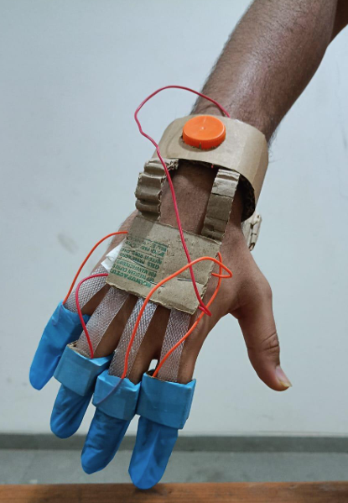
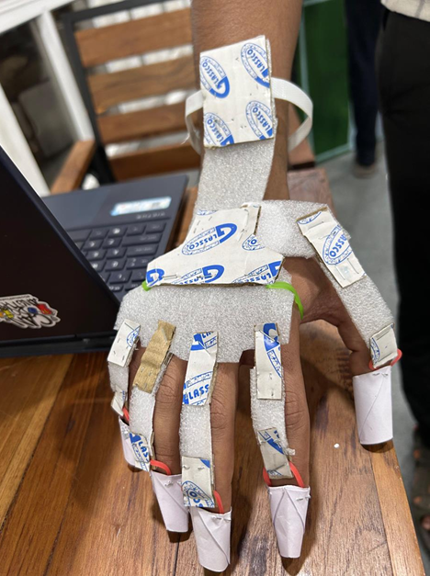
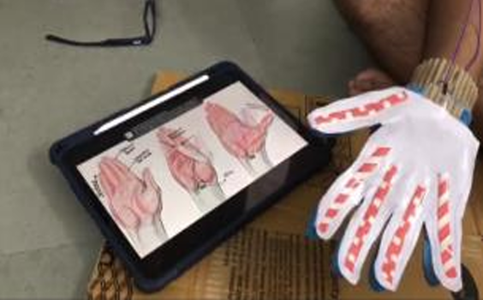
Setup/Design (Low Fidelity Mockups)
Fig. 1.2: Non-functional form for visual reference.
Fig. 1.1: Non-functional form for visual reference.
Fig. 1.3: Non-functional form for visual reference.

Slide 7
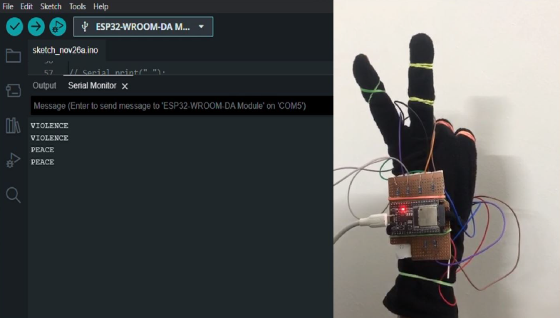
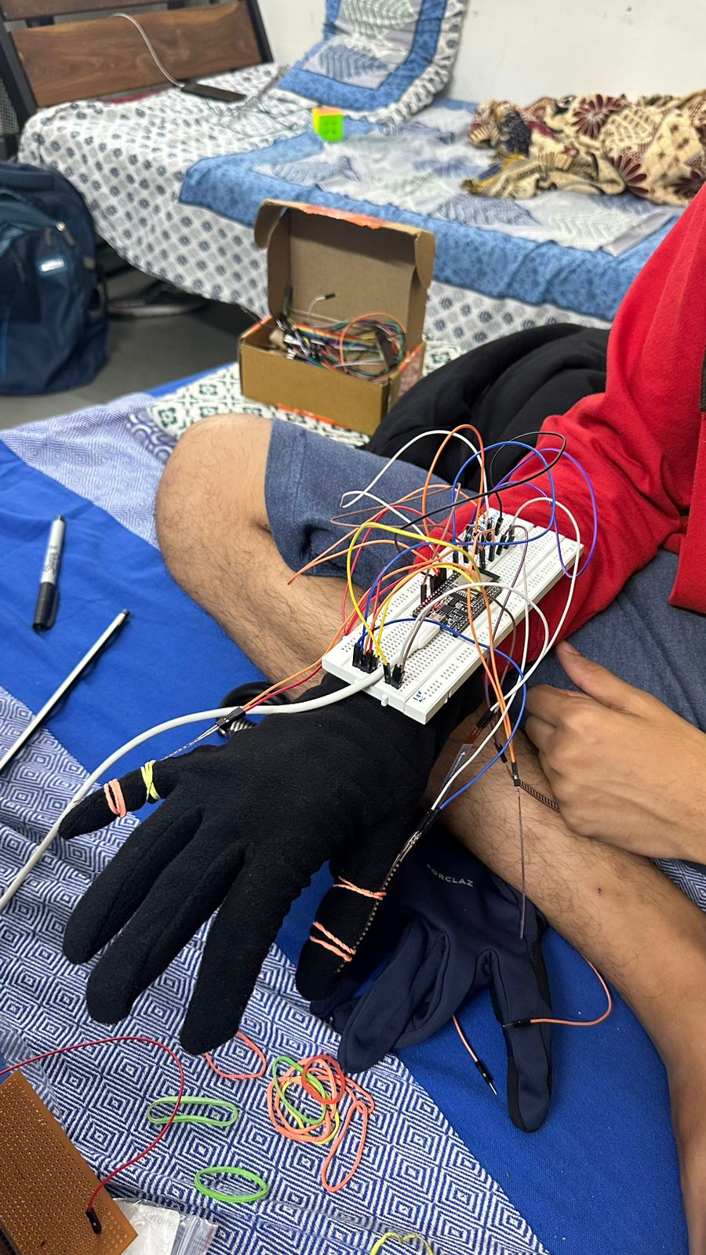
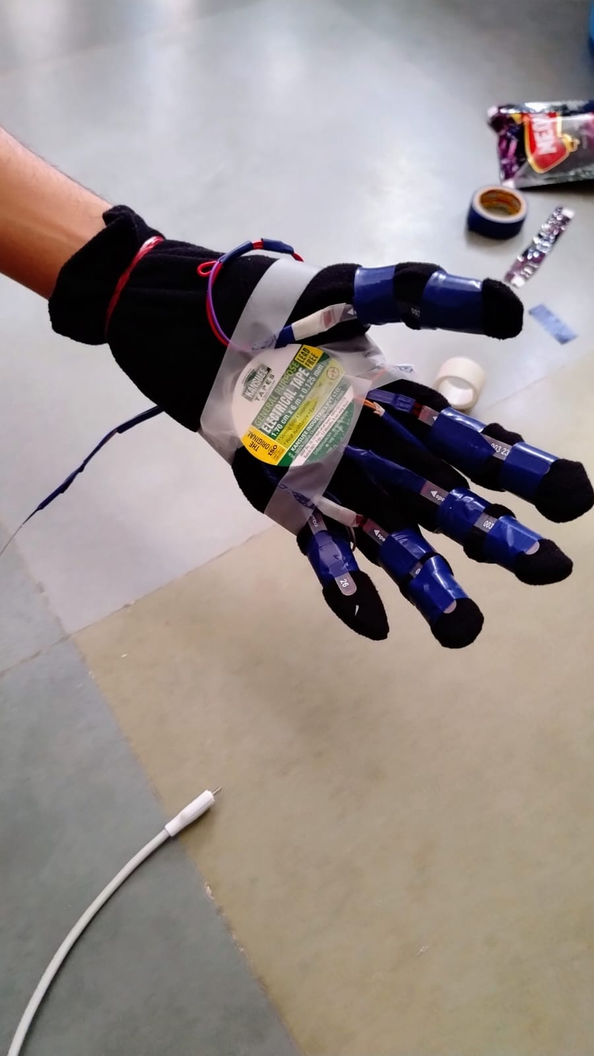
Design
Fig. 3.1: Demonstration of basic gestures.
Fig. 3.2: First Functional Prototype
Fig. 3.3: First Prototype

Slide 8
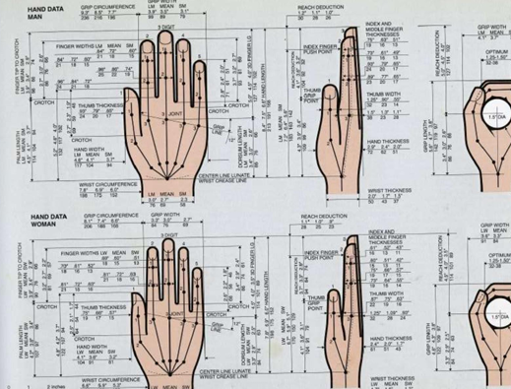
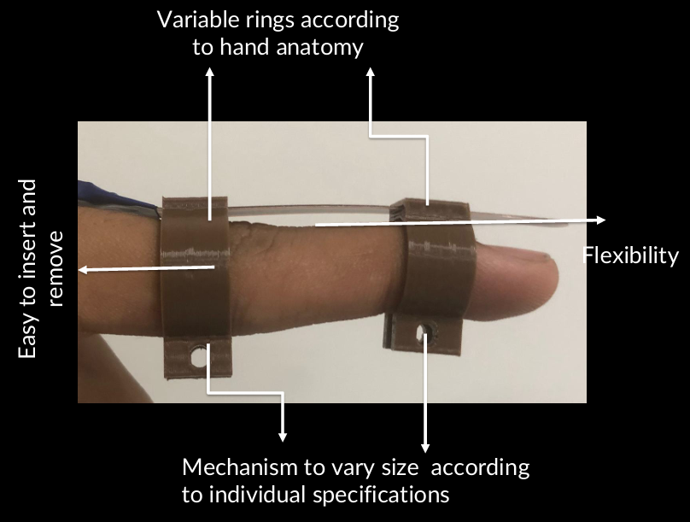
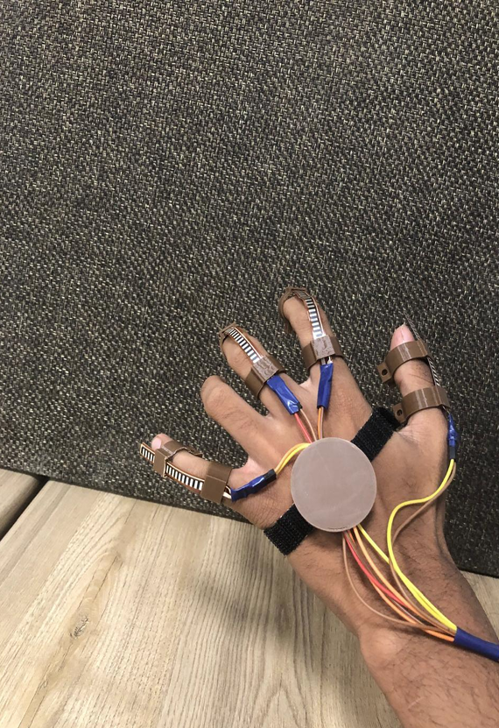
Design (ES115)
Fig. 2: Ergonomics
Fig. 2.1: Ergonomics
Fig. 2.2: Ergonomic modular structure.

Slide 9
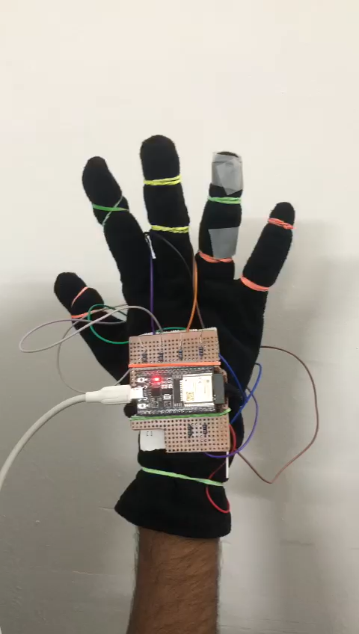
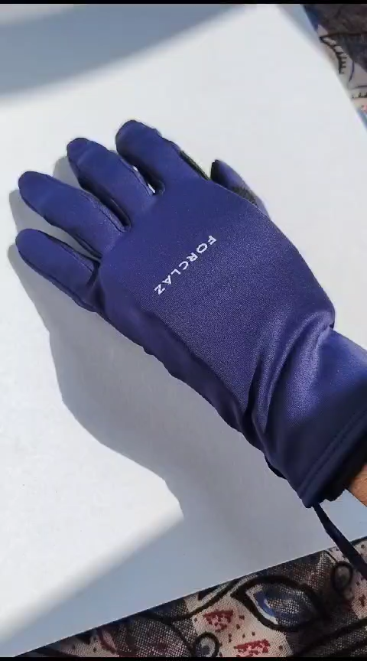
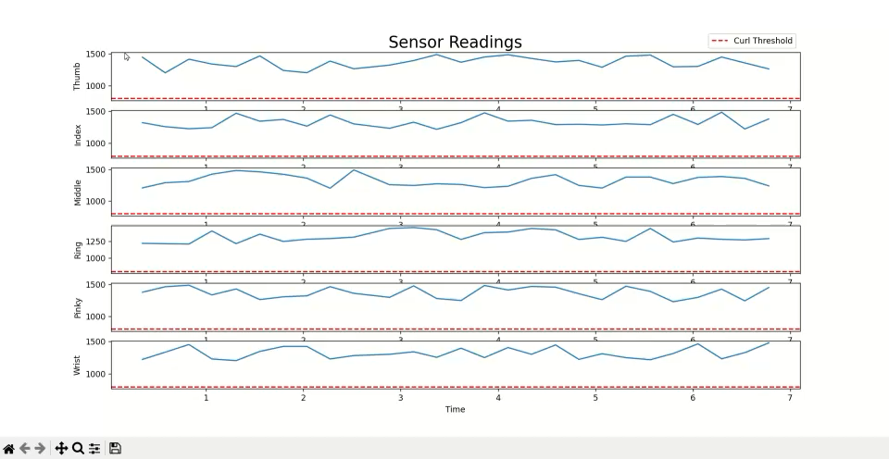
Working
Fig. 4.1: Demonstration of first real time data acquisition.
Fig. 4.2: Flex sensor initialisation.
Fig. 4.3: High Fidelity Prototype 1.

Slide 10
Data Processing
We tried various approaches to filtering data sampled at 100 Hz.
Low-Pass Filters: We implemented a moving average of the data to get rid of high-frequency noise.
Peak Detection Algorithm: To identify specific gestures or movements, we implemented a peak detection algorithm to identify when a finger was bent beyond a certain threshold. [5] We implemented this algorithm to create a simple Flappy Bird game.
The system was designed to be lightweight, comfortable to wear, and unobtrusive during rehabilitation exercises, while still providing reasonable tracking of hand movements

Slide 11
What could we not do ?
Complete integration and data processing of IMU sensors into Unity for hand orientation tracking for pick-and-place type of games. We were only able to implement the data from the flex sensors completely
Clinical Efficacy Testing, as this was done within the scope of a course, the team could not gather data from stroke patients to give any statistical validity. Data from healthy individuals also showed insufficient convergence.
Comparative Analysis, to compare outcomes and user experience with traditional rehabilitation methods such as constraint-induced movement therapy, as we were unaware of the correct medical procedure to perform the same (even on healthy individuals).
Manufacture DIY scale PCB for a more compact modular processing unit, and complement it with our ring-based design for complete functionality.

Slide 12
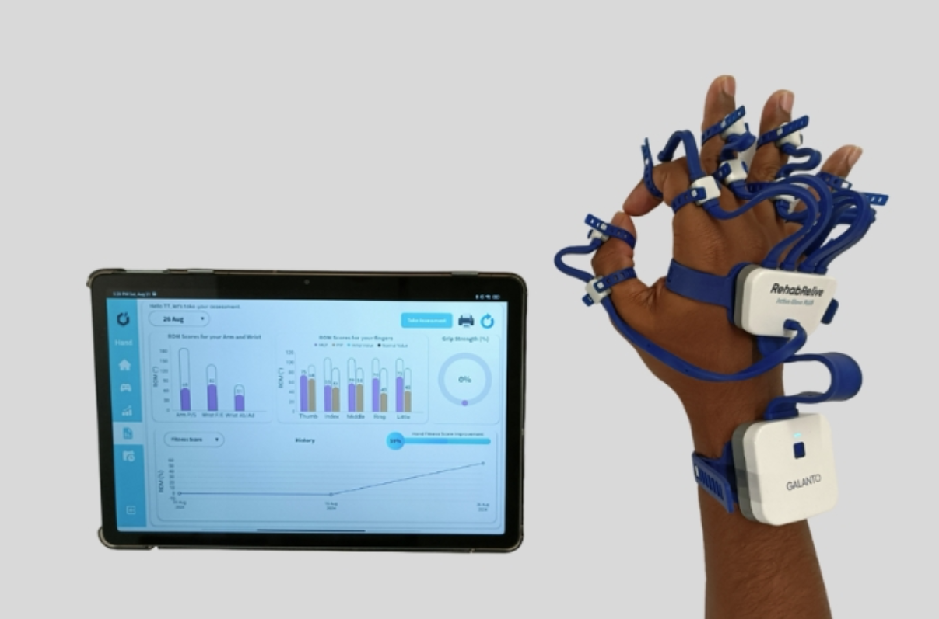
Case Study: Galanto Innovation
A startup incubated in our very own IIT Gandhinagar community was very insightful. It worked on the same problem we have but at a production scale. Dr. Chandan Kumar Jha, the co-founder of the company, was kind enough to deliver a guest lecture for our class. Their model is far more precise and uses optical flex sensors to get an accuracy of up to 0.1 degrees of motion.
Fig. 5.1: Galanto Innovation’s RehabRelive. A rehabilitation glove with 13 fine and gross Range of Motion trackers. (Clinical Version)

Slide 13
References
C. C. Physiotherapy, “Don’t miss out on hand therapy robotic gloves – Revolutionary tool for stroke rehab,” CCPhysiotherapy.com. [Online]. Available: https://www.ccphysiotherapy.com/stroke/dont-miss-out-on-hand-therapy-robotic-gloves-revolutionary-tool-for-stroke-rehab/. [Accessed: Oct 25, 2023].
F. Song, J. Yao, and H. Ni, “A review on robotic-assisted rehabilitation devices for post-stroke recovery,” Frontiers in Neurorobotics, vol. 17, 2023. [Online]. Available: https://www.ncbi.nlm.nih.gov/pmc/articles/PMC10295999/. [Accessed: Oct 25, 2023].
A. Duret et al., “Hand rehabilitation using robotic glove: A pilot randomized controlled trial in patients with chronic stroke,” Frontiers in Neurology, vol. 13, 2022. [Online]. Available: https://www.ncbi.nlm.nih.gov/pmc/articles/PMC9381330/. [Accessed: Oct 25, 2023].
Neofect, "5 Innovative Ways to Use Games for Healthcare," Neofect Blog, [Online]. Available: https://www.neofect.com/us/blog/ways-to-use-games-for-healthcare. [Accessed: Oct 28, 2023].
Qsilverrdc, “How to detect a peak and low in noisy data,” Arduino Forum, Jan. 12, 2021. [Online]. Available: https://forum.arduino.cc/t/how-to-detect-a-peak-and-low-in-noisy-data/690968. [Accessed: Nov 1, 2023].

Slide 14
FIX IT BEFORE NEXT PRESENTATION
Calibration for stroke patients.
Sensorfusion architecture
Data Filtering, Sampling, Signal Processing
Real-time syncing

